Slide 1
Object Data Model
CSIT882: Data Management Systems
Notes:
<!-- Neural, Brian, Male, British English. -->
<speak>
<break time="0.5s"/>
<prosody rate="90%">
Object data model.
<break time="0.3s"/>
This video presents few graphical notations, that can be used in a process of conceptual modeling.
<break time="0.3s"/>
</prosody>
</speak>
1
Systems Analysis

Slide 2
Outline
Graphical Notations for Conceptual Modeling
(Simplified) Class of Objects
Association
Link Attribute
Association Class
Qualification
Generalisation
2
Notes:
<!-- Neural, Brian, Male, British English. -->
<speak>
<break time="0.5s"/>
<prosody rate="90%">
Graphical notations for conceptual modeling.
<break time="0.3s"/>
</prosody>
</speak>
Systems Analysis
2

Slide 3
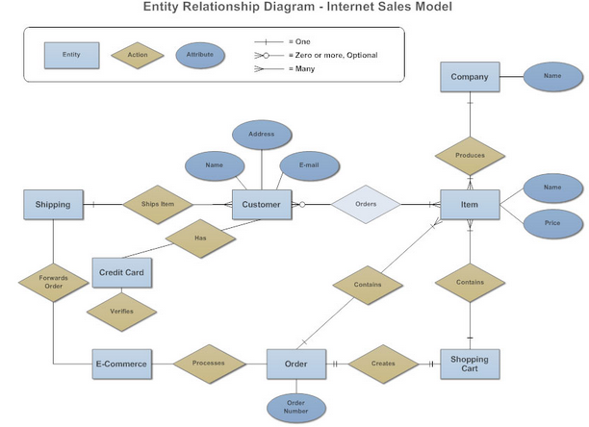
Graphical Notations for Conceptual Modeling
Entity-Relationship (ER) diagrams (1976)
3
Notes:
<!-- Neural, Brian, Male, British English. -->
<speak>
<break time="0.5s"/>
<prosody rate="90%">
A graphical notation of entity-relationship diagrams (commonly called E R diagrams) was developed in 1976 by Peter Chen.
<break time="0.3s"/>
A database domain is represented in a notation of E R diagrams by the entity types, attributes describing entity types, relationships between the entity types and identifiers of entity types.
<break time="0.3s"/>
An entity type is visualised on the slide as a rectangle in dark blue colour.
<break time="0.3s"/>
An entity type has a name located within a rectangle
<break time="0.3s"/>A relationship is visualised as a diamond in a light brown colour, and connected by straight lines to the rectangles representing the entity types.
<break time="0.3s"/>
An attribute describing an entity type or a relationship is visualised as an oval in dark blue colour, and connected by a straight line to an entity type or to a relationship.
<break time="0.3s"/>
An E R diagram visualised on the slide represents a database domain, where the customers submit the orders that consists of items.
<break time="0.3s"/>
The items are produced by the companies.
<break time="0.3s"/>
The items are stored by the customers in their shopping carts.
<break time="0.3s"/>
The orders are shipped to the customers.
<break time="0.3s"/>
</prosody>
</speak>
Systems Analysis
3

Slide 4
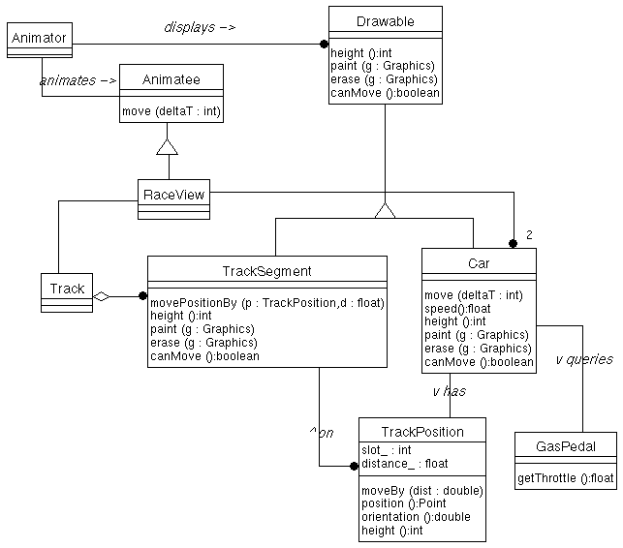
Graphical Notations for Conceptual Modeling
Object Modelling Technique (OMT) diagrams (1991)
Black dot means more than one.
4
Notes:
<!-- Neural, Brian, Male, British English. -->
<speak>
<break time="0.5s"/>
<prosody rate="90%">
A graphical notation of object modelling technique diagrams (commonly called O M T diagrams) was developed in 1991 by Rumbaugh, Blaha, Premerlani, Eddy and Lorensen.
<break time="0.3s"/>
O M T consists of three types of models:<break time="0.3s"/> object model, dynamic model and functional model.
<break time="0.3s"/>
An object model can be used for conceptual modelling.
<break time="0.3s"/>
A database domain is represented in a notation of object model of O M T diagrams by the classes of objects, properties describing classes of objects, associations between the classes of objects and generalisation hierarchies.
<break time="0.3s"/>
A class of objects is visualised as rectangle, that contains the name of a class of objects, the names of properties and the names of methods (operations) applicable to a class of objects.
<break time="0.3s"/>
An association is visualised as a line connecting the classes of objects.
<break time="0.3s"/>
An association has a name located close to a line and a direction indicator.
<break time="0.3s"/>
A generalisation is visualised as a small triangle with the lines, that link subclasses and super classes of objects.
<break time="0.3s"/>
An O M T diagram visualised on the slide represents a database domain, where the animators display drawable objects.
<break time="0.3s"/>
There are two types of drawable objects: track segments and cars.
<break time="0.3s"/>
The tracks consist of the track segments.
<break time="0.3s"/>
The cars have the positions located on the track segments.
<break time="0.3s"/>
The animators animate the animatees.
<break time="0.3s"/>
</prosody>
</speak>
Systems Analysis
4

Slide 5
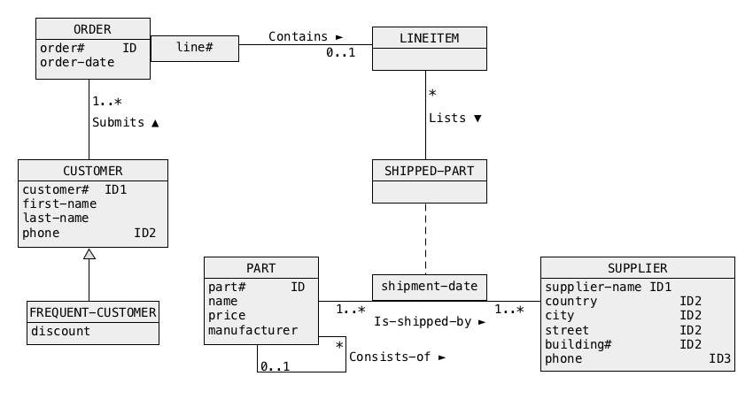
Graphical Notations for Conceptual Modeling
(Simplified) Unified Modelling Language (UML) Object Class diagrams (1994)
5
Notes:
<!-- Neural, Brian, Male, British English. -->
<speak>
<break time="0.5s"/>
<prosody rate="90%">
A graphical notation of Unified Modelling Language (commonly called as U M L diagrams), has been developed between 1994 and 1995 by Booch, Jacobson and Rumbaugh at Rational Software.
<break time="0.3s"/>
U M L consists of three types of diagrams:<break time="0.3s"/> structure diagrams, behaviour diagrams and interaction diagrams.
<break time="0.3s"/>
Structure diagrams consist of component diagrams and object class diagrams.
<break time="0.3s"/>
A simplified notation of object class diagrams can be used for conceptual modelling.
<break time="0.3s"/>
A database domain is represented in a notation of simplified object class diagrams by the classes of objects, properties describing classes of objects, identifiers of the classes of objects, associations between the classes of objects, association classes, qualifications, and generalisation hierarchies.
<break time="0.3s"/>
A class of objects is visualised as a rectangle, that contains a name of a class of objects and the names of properties.
<break time="0.3s"/>
A set of attributes that can be used for identification purposes is denoted by I D tags.
<break time="0.3s"/>
An association is visualised as a line connecting the classes of objects.
<break time="0.3s"/>
An association has a name located close to a line and a direction indicator.
<break time="0.3s"/>
A generalisation is visualised as a small triangle with the lines that link subclasses and super classes of objects.
<break time="0.3s"/>
A qualification is visualised as a rectangle attached to a class of objects and connected to an association.
<break time="0.3s"/>
An O M T diagram visualised on the slide represents a database domain, where the customers submit orders, that consist of lines.
<break time="0.3s"/>
A line contains a description of a part included in an order and supplied by a supplier.
<break time="0.3s"/>
A part consists of other parts.
<break time="0.3s"/>
A class of frequent customers is a subset of a class of customers.
<break time="0.3s"/>
A line in an order is uniquely identified by an order number and line number.
<break time="0.3s"/>
</prosody>
</speak>
Systems Analysis
5

Slide 6
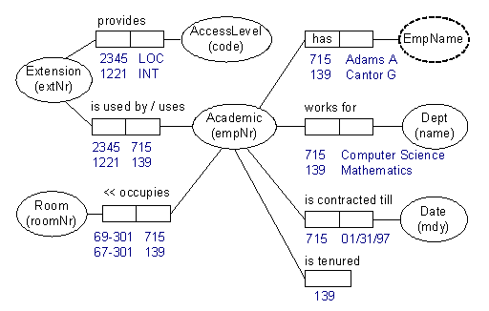
Graphical Notations for Conceptual Modeling
Object Role Modeling (ORM) diagrams
... and many, many, ... other graphical notations
6
Notes:
<!-- Neural, Brian, Male, British English. -->
<speak>
<break time="0.5s"/>
<prosody rate="90%">
A graphical notation of Object Role Modeling (commonly called as O R M diagrams), was developed in mid-1970s by Nijssen.
<break time="0.3s"/>
O R M diagrams can be used for conceptual modelling.
<break time="0.3s"/>
<break time="0.3s"/>
A database domain is represented in O R M notation by the facts, objects involved in the facts, and roles played by the objects in the facts.
<break time="0.3s"/>
O R M notation is attribute free, unlike E R notation or U M L classes of objects notation.
<break time="0.3s"/>
A fact is a proposition, like James plays a football game today.
<break time="0.3s"/>
Ovals are used for visualisation of objects
<break time="0.3s"/>
Pairs of adjacent rectangles are used for visualisation of roles played by the objects in facts.
<break time="0.3s"/>
An O R M diagram visualised on the slide represents a database domain, where the employees have employee numbers and occupy a room.
<break time="0.3s"/>
An employee works for a department and has an extension number and access level code.
<break time="0.3s"/>
An employee is contracted or tenured.
<break time="0.3s"/>
</prosody>
</speak>
Systems Analysis
6

Slide 7
Outline
Graphical Notations for Conceptual Modeling
(Simplified) Class of Objects
Association
Link Attribute
Association Class
Qualification
Generalisation
7
Notes:
<!-- Neural, Brian, Male, British English. -->
<speak>
<break time="0.5s"/>
<prosody rate="90%">
Simplified class of objects.
<break time="0.3s"/>
</prosody>
</speak>
Systems Analysis
7

Slide 8

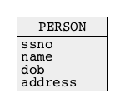
(Simplified) Class of Objects
A database suppose to contain information about people
A rectangular box with a header and a name of class (PERSON) inside a header represents a (simplified) class of objects
A person is described by a social security number, name, date of birth and address
The names of attributes are listed within a rectangular box one name of attribute per row
8
Notes:
<!-- Neural, Brian, Male, British English. -->
<speak>
<break time="0.5s"/>
<prosody rate="90%">
Let us assume, that a sample database is supposed to contain information about people.
<break time="0.3s"/>
A rectangular box visible above, with a header that includes a name of a class person, represents a simplified class of objects.
<break time="0.3s"/>
In the future, we shall refer to the simplified class of objects as a class of objects.
<break time="0.3s"/>
Let us assume, that a person is described by a social security number, name, date of birth and address.
<break time="0.3s"/>
The names of attributes are listed within a rectangular box, that represents a class of objects, one name of attribute, per row.
<break time="0.3s"/>
The names of attributes are listed below a header of a class of objects, where s s n o represents a social security number, name represemts a name of a person, d o b represents a date of birth,
and finally, address represents an address of a person.
<break time="0.3s"/>
</prosody>
</speak>
Systems Analysis
8

Slide 9
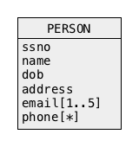
(Simplified) Class of Objects
A person has from one to five email addresses and zero or more phone numbers
Multiplicity of attribute like:
- [1..5] from one to five,
- [*] or [0..*] zero or more ,
- [1..*] one or more,
- [0..1] optional, zero or one,
- [m..n] from "m" to "n"
follows a name of attribute
Default multiplicity is "one" [1]
9
Notes:
<!-- Neural, Brian, Male, British English. -->
<speak>
<break time="0.5s"/>
<prosody rate="90%">
Let us assume, that a person has no more than five email addresses and none or more mobile phone numbers.
<break time="0.3s"/>
The attributes like: <break time="0.3s"/>email, and phone, are multivalued attributes.
<break time="0.3s"/>
The complex values of multivalued attributes are the sets of atomic values.
<break time="0.3s"/>
The minimum and maximum total number of atomic values within a complex value of a multivalued attribute, is called as multiplicity of an attribute.
<break time="0.3s"/>
A suffix like [ 1 dot dot 5 ] within the square brackets, at the end of the attribute name indicates a multivalued attribute.
<break time="0.3s"/>
A suffix [ 1 dot dot 5 ] means, that a complex value of a multivalued attribute, must have at least one atomic value and no more than 5 values.
<break time="0.3s"/>
A suffix like [ star ] or [ 0 dot dot star ] means a complex value, that consists of zero or more atomic values.
<break time="0.3s"/>
A suffix like [ 1 dot dot star ] means a complex value, that consists of at least one or more atomic values.
<break time="0.3s"/>
A suffix like [ m dot dot n ] means a complex value that consists of at least m atomic values and at most n atomic values.
<break time="0.3s"/>
Default multiplicity of an attribute is [ 1 ].
<break time="0.3s"/>
It means that all attributes, that do not have a suffix, like for example, social security number, name, date of birth, must have precisely one value.
<break time="0.5s"/>
</prosody>
</speak>
Systems Analysis
9

Slide 10
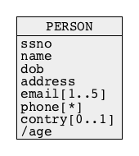
(Simplified) Class of Objects
A person is described by an optional country of origin and age (/ in front of attribute name age denotes a derived attribute)
10
Notes:
<!-- Neural, Brian, Male, British English. -->
<speak>
<break time="0.5s"/>
<prosody rate="90%">
Let us assume, that additionally, a person is described by an optional country of origin, and by age.
<break time="0.3s"/>
A suffix [ 0 dot dot 1 ] appended at the end of a name of attribute country, means that a value of the attribute is optional.
<break time="0.3s"/>
It means, that a name of a country can be provided or not.
<break time="0.3s"/>
An optional attribute may have at most 1 value, or no values at all.
<break time="0.3s"/>
A forward slash in front of an attribute, age, means that an attribute is derived.
<break time="0.3s"/>
A value of derived attribute, can be computed from the values of the other attributes or constants.
<break time="0.3s"/>
A value of an attribute age, can be computed using a value of the attribute date of birth, and the current date.
<break time="0.5s"/>
</prosody>
</speak>
Systems Analysis
10

Slide 11
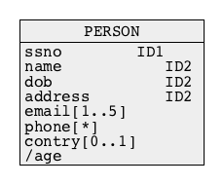
(Simplified) Class of Objects
A person is identified by a social security number and independently by a triple (name, date of birth, address)
A tag IDx following a name of attribute means that an attribute is an identifier标识符
If the same tag (e.g. ID2) follows the names of several attributes then it means that an identifier consists of several attributes
If an identifier consists of several attributes then it means that each object in a class is identified by a tuple元组 of values of the attributes
An identifier which consists of several attributes is called as a composite identifier复合标识符
11
Notes:
<!-- Neural, Brian, Male, British English. -->
<speak>
<break time="0.5s"/>
<prosody rate="90%">
Let us assume, that a person is identified by a social security number, and independently by a triple of the attributes that consists of a name, date of birth, and address.
<break time="0.3s"/>
Such identification means, that in this case no two people have the same social security number and the same triple of values of the attributes name, date of birth and address.
<break time="0.3s"/>
A tag I D digit, following a name of an attribute means, that such attribute is an identifier.
<break time="0.3s"/>
For example, a tag I D 1 following a name of attribute social security number, means that a social security number is an identifier.
<break time="0.3s"/>
If the same tag, for example I D 2 follows the names of several attributes then, it means that an identifier consists of several attributes.
<break time="0.3s"/>
If an identifier consists of several attributes, then it means that each object in a class is identified by a tuple of values of such attributes.
<break time="0.3s"/>
An identifier, that consists of several attributes is called as a composite identifier.
<break time="0.5s"/>
</prosody>
</speak>
Systems Analysis
11

Slide 12
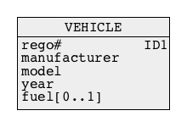
(Simplified) Class of Objects
A vehicle is described by a registration number, manufacturer, model, year when manufactured and optional fuel consumption
Each vehicle has a different registration number
12
Notes:
<!-- Neural, Brian, Male, British English. -->
<speak>
<break time="0.5s"/>
<prosody rate="90%">
Let us consider another example of a class of objects.
<break time="0.3s"/>
Assume, that a database is supposed to contain information about vehicles.
<break time="0.3s"/>
Assume, that a vehicle is described by a registration number, manufacturer, model, year when manufactured and optional fuel consumption.
<break time="0.3s"/>
Our knowledge of the database domain being modelled (the reality) contributes to a fact that each vehicle has a different registration number.
<break time="0.3s"/>
A class vehicle visualised on the slide, is described by 5 attributes: rego number, (registration number), manufacturer, model, year and fuel.
<break time="0.3s"/>
An attribute fuel is an optional attribute.
<break time="0.3s"/>
It means, that its value can be omitted.
<break time="0.3s"/>
All other attributes are compulsory.
<break time="0.3s"/>
It means, that their values must be provided.
<break time="0.3s"/>
All attributes being the identifiers or being the components of identifiers, must be compulsory.
<break time="0.5s"/>
</prosody>
</speak>
Systems Analysis
12

Slide 13
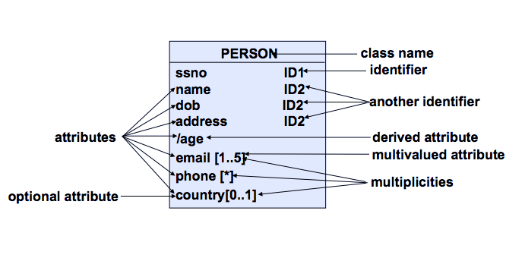
(Simplified) Class of Objects
Summary
派生属性
多重性
13
Notes:
<!-- Neural, Brian, Male, British English. -->
<speak>
<break time="0.5s"/>
<prosody rate="90%">
A short summary.
<break time="0.3s"/>
A class of objects represents a set of homogeneous real world objects, described by the same set of attributes, and related to other classes of objects by the same set of associations.
<break time="0.3s"/>
A class of objects is visualised as a single column table with a name of a class in a header and a list of attributes below a header.
<break time="0.3s"/>
The [ m dot dot n] tags following the names of attributes indicate that such attributes are multivalued attributes.
<break time="0.3s"/>
The [ 0 dot dot 1 ] tags following the names of attributes indicate that such attributes are optional attributes.
<break time="0.3s"/>
The I D digit tags following the names of attributes indicate, that such attributes are identifiers, or they are the members of identifiers.
<break time="0.3s"/>
A forward slash preceding a name of attribute indicates, that such attribute is a derived attribute.
<break time="0.5s"/>
</prosody>
</speak>
Systems Analysis
13

Slide 14
Outline
Graphical Notations for Conceptual Modeling
(Simplified) Class of Objects
Association
Link Attribute
Association Class
Qualification
Generalisation
14
Notes:
<!-- Neural, Brian, Male, British English. -->
<speak>
<break time="0.5s"/>
<prosody rate="90%">
Association.
<break time="0.5s"/>
</prosody>
</speak>
Systems Analysis
14

Slide 15
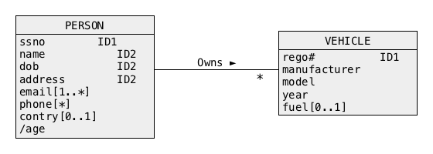
Association 关联
A person owns a vehicle
A solid line that connects two classes represents an association
A name above a line is an association name
An association name if followed (preceded or located above or below) by a small solid triangle, that represents a direction of interpretation of an association
15
Notes:
<!-- Neural, Brian, Male, British English. -->
<speak>
<break time="0.5s"/>
<prosody rate="90%">
Let us assume, that a database is supposed to contain information about peoples, vehicles, and owners of vehicles.
<break time="0.3s"/>
To represent people and vehicles, we create the classes of objects: person and vehicle.
<break time="0.3s"/>
The same classes of objects have already been created, and described in the previous presentation.
<break time="0.3s"/>
A fact, that a person owns a car, can be represented by an abstract link between an instance of a class person and an instance of a class car.
<break time="0.3s"/>
When the instances of the objects are represented as the icons on a computer screen, then an abstract link is a line connecting two icons.
<break time="0.3s"/>
In this case it is an icon of a person and an icon of a car.
<break time="0.3s"/>
A collection of the homogeneous links between the objects, is called an association.
<break time="0.3s"/>
An association is visualised as a solid line that connects the visualisation of two classes of objects.
<break time="0.3s"/>
A name above an association line is an association name.
<break time="0.3s"/>
In our case association name is, Owns, and the association can be interpreted as a person who owns a vehicle.
<break time="0.3s"/>
A direction of interpretation is determined by a small solid triangle, that follows a name of an association.
<break time="0.3s"/>
So, in this case, it is definitely not, a vehicle owns a person.
<break time="0.3s"/>
A star symbol located on the right hand side of association, is a multiplicity of association, and in this case, it means that a person owns zero or more cars.
<break time="0.3s"/>
A default value of multiplicity is one.
<break time="0.3s"/>
It also means that a car has only one owner and, that each car must have an owner.
<break time="0.3s"/>
Multiplicities of associations will be thoroughly discussed later in this presentation.
<break time="0.5s"/>
</prosody>
</speak>
Systems Analysis
15

Slide 16
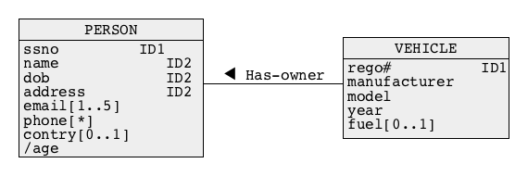
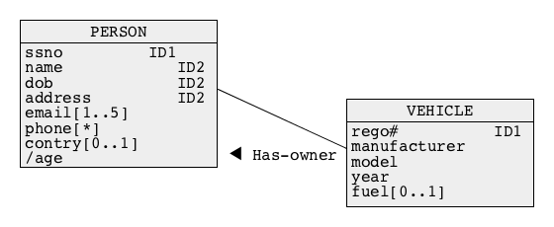
Association
A vehicle has an owner
Locations of classes and associations in a diagram are immaterial
16
Notes:
<!-- Neural, Brian, Male, British English. -->
<speak>
<break time="0.5s"/>
<prosody rate="90%">
The topmost conceptual schema in this slide, represents a bit of an unrealistic situation, where each person owns precisely one car, and where each car has one owner.
<break time="0.3s"/>
The multiplicities on both sides of an association has, take the default value of one.
<break time="0.3s"/>
Locations of classes and associations in a diagram are immaterial, however incorrect placement of the visualisations of classes of objects may contribute to poor readability of a conceptual schema.
<break time="0.5s"/>
</prosody>
</speak>
Systems Analysis
16

Slide 17
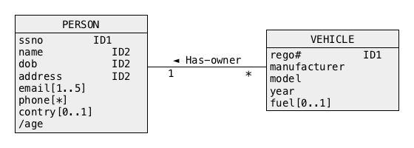
Association
A person owns zero or more vehicles
A vehicle has one owner
Multiplicities of association are located at both ends of a line that represents an association
17
Notes:
<!-- Neural, Brian, Male, British English. -->
<speak>
<break time="0.5s"/>
<prosody rate="90%">
Both conceptual schemas visualised in the slide, represent a situation, where a person owns zero or more vehicles, and a vehicle has precisely one owner.
<break time="0.3s"/>
In this case, we do not take under consideration vehicles after very serious accidents, whose owners unfortunately did not survive an accident.
<break time="0.3s"/>
In the upper diagram, we use a default value of a multiplicity of an association has owner, on an, owner, side of association.
<break time="0.3s"/>
In the lower diagram, the multiplicities of an association, has owner, are located at both ends of a line that represents the association.
<break time="0.5s"/>
</prosody>
</speak>
Systems Analysis
17

Slide 18
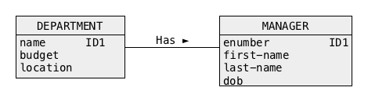
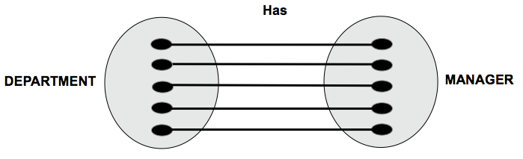
Association
One-to-one association
- A department has a manager
- A department has exactly one manager
- A person who is a manager manages exactly one department
18
Notes:
<!-- Neural, Brian, Male, British English. -->
<speak>
<break time="0.5s"/>
<prosody rate="90%">
Now, we shall look at the details of the multiplicities of associations.
<break time="0.3s"/>
We start from one to one association.
<break time="0.3s"/>
One to one, means that multiplicity on both sides of an association is at most one.
<break time="0.3s"/>
We consider a conceptual schema, that represents a database domain, where departments have managers.
<break time="0.3s"/>
In our case, a department has exactly one manager, and a person who is a manager, manages exactly one department.
<break time="0.3s"/>
An instance diagram, below a conceptual schema, shows the instances objects in a class department visualised as the small black ovals,
and the instances of objects in a class manager also visualized as the small black ovals.
<break time="0.3s"/>
The abstract links between the instances of departments, and the instances of managers, represent information who is a manager of which department.
<break time="0.3s"/>
The abstract links, are visualised in the instance diagram, as straight lines linking the black ovals, representing the instances of objects.
<break time="0.3s"/>
It is clearly visible that multiplicity of an association: has, is one to one because each instance of an object in a class department is linked exactly to one instance of an object in a class manager.
<break time="0.3s"/>
And each instance of an object in a class manager, is linked to exactly one instance of an object in class department.
<break time="0.5s"/>
</prosody>
</speak>
Systems Analysis
18

Slide 19
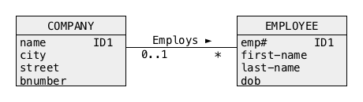
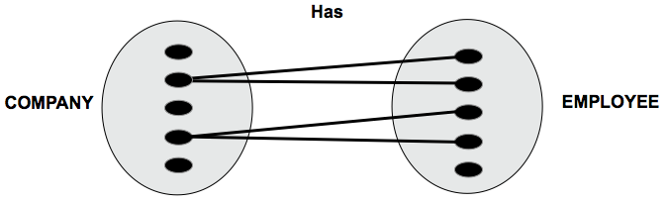
Association
One-to-many association
- A company employs an employee
- A company employes many employees
- An employee works for none or one company
- It is possible that a company has no (zero) employees
19
Notes:
<!-- Neural, Brian, Male, British English. -->
<speak>
<break time="0.5s"/>
<prosody rate="90%">
Next, we look at an example of a conceptual schema, that represents a database domain, where companies employ employees.
<break time="0.3s"/>
A company employs many employees, and an employee is employed by zero or more companies.
<break time="0.3s"/>
It is also possible, that a company has no (zero) employees.
<break time="0.3s"/>
It is an example of one to many association, or many to one, well, it really does not matter, because in both cases, it is the same association.
<break time="0.3s"/>
One to many means, that multiplicity of an association on one side is one, or, zero or one, and multiplicity of the same association on the other side is many, or zero or many.
<break time="0.3s"/>
An instance diagram below a conceptual schema shows the instances objects in a class company, visualised as the small black ovals
and the instances of objects in a class employee, also visualised as the small black ovals.
<break time="0.3s"/>
The abstract links between the instances of companies, and the instances of employees, represent information who is employed by which company.
<break time="0.3s"/>
The abstract links are visualized in the instance diagram, as straight lines linking the black ovals representing the instances of objects.
<break time="0.3s"/>
It is clearly visible that multiplicity of an association, employs, is one to many because the instances of an object in a class company, are linked to none or many instances of an object in a class employee.
<break time="0.3s"/>
And each instance of an object in a class employee, is linked at most to one instance of an object in a class company.
<break time="0.3s"/>
It is possible that a company does not employ any employees and some employees, hopefully temporary, are not employed by any company.
<break time="0.3s"/>
It means that an association, owns, is optional at both of its sides.
<break time="0.5s"/>
</prosody>
</speak>
Systems Analysis
19

Slide 20
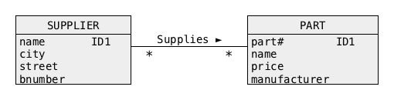
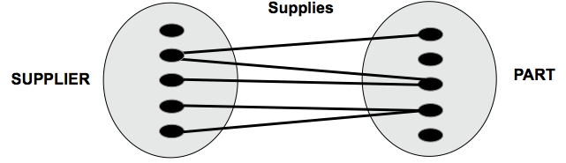
Association
Many-to-many association
- A supplier supplies a part
- A supplier supplies zero or more parts
- A part is supplied by zero or more suppliers
20
Notes:
<!-- Neural, Brian, Male, British English. -->
<speak>
<break time="0.5s"/>
<prosody rate="90%">
Next, we look at an example of a conceptual schema, that represent a database domain where suppliers supply parts.
<break time="0.3s"/>
A supplier supplies zero or more parts, and a part can be supplied by zero or more suppliers.
<break time="0.3s"/>
It is an example of many to many association.
<break time="0.3s"/>
Many to many means, that multiplicity of an association on its both sides is zero or many, if an association is optional on both sides.
<break time="0.3s"/>
If many to many association is not optional on one its sides, then a multiplicity on such side is one or many.
<break time="0.3s"/>
An instance diagram below a conceptual schema, shows the instances objects in a class supplier, visualised as the small black ovals,
and the instances of objects in a class part, also visualized as the small black ovals.
<break time="0.3s"/>
The abstract links between the instances of suppliers, and the instances of parts, represent information which supplier supplies which part.
<break time="0.3s"/>
The abstract links are visualised in the instance diagram, as straight lines linking the black ovals representing the instances of objects.
<break time="0.3s"/>
It is clearly visible, that a multiplicity of an association, supplier supplies parts, is many to many, because the instances of an object in a class supplier are linked to none or many instances of an object in a class part.
<break time="0.3s"/>
And each instance of an object in a class parts is linked to zero or more objects in a class supplier.
<break time="0.3s"/>
It is possible that a supplier does not supply any part, for example, a supplier is on leave just now.
<break time="0.3s"/>
It is also possible that a part is not supplied by any supplier because manufacturing of such part has been terminated by a manufacturer.
<break time="0.3s"/>
It means that an association, supplier supplies parts, is optional at both of its sides.
<break time="0.5s"/>
</prosody>
</speak>
Systems Analysis
20

Slide 21
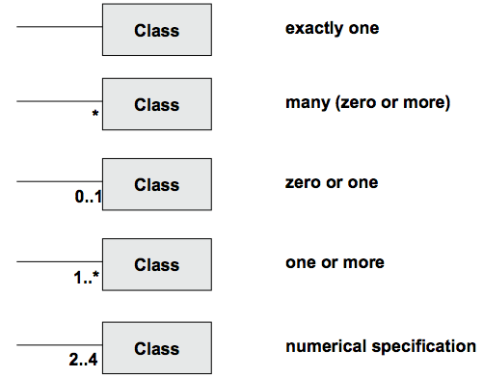
Association
Summary
21
Notes:
<!-- Neural, Brian, Male, British English. -->
<speak>
<break time="0.5s"/>
<prosody rate="90%">
A short summary.
<break time="0.3s"/>
If there is no symbol at a location where a line representing an association is connected to a class of objects, then the multiplicity on this side of association is one.
<break time="0.3s"/>
A star symbol in the same location means, that multiplicity on this side of association is zero or many.
<break time="0.3s"/>
A symbol zero dot dot one, means, that multiplicity on this side of association is zero or one, or it is optional.
<break time="0.3s"/>
A symbol one dot dot star, means, that multiplicity on this side of association is one or many.
<break time="0.3s"/>
A symbol 2 dot dot 4, means that minimum multiplicity is 2 and maximum multiplicity is 4.
<break time="0.3s"/>
Two nice examples of the associations, where a numerical specification multiplicity must be used, are presented on the next slide.
<break time="0.5s"/>
</prosody>
</speak>
Systems Analysis
21

Slide 22
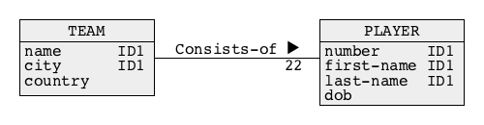
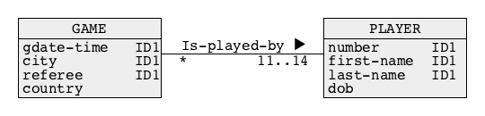
Association
More examples:
A team consists of 22 players
A player belongs to only one team
A game is played by 11players plus maximum 3 substitutes
A player participates in zero or more games
22
Notes:
<!-- Neural, Brian, Male, British English. -->
<speak>
<break time="0.5s"/>
<prosody rate="90%">
First, we consider a database domain where football teams consist of players.
<break time="0.3s"/>
In such database domain, football means a game where two teams, that consist of eleven players on a field, play with a round ball, and not with an egg.
<break time="0.3s"/>
In a general case, a football team consists of 22 players, because so many players can be registered for a major tournament.
<break time="0.3s"/>
A player belongs to only one team.
<break time="0.3s"/>
Therefore, a multiplicity of an association, team consists of players, is one to 22 if we look at it from the teams side.
<break time="0.3s"/>
It is 22 to 1 if we look at it from the players side.
<break time="0.3s"/>
In the example below, we consider a database domain, where football games are played by the players.
<break time="0.3s"/>
A game is played by a minimum of 11 players (in fact it can be less than 11 but, it would be a shame to start a football game with less than 11 players), plus a maximum of 3 substitutes.
<break time="0.3s"/>
It makes the maximum number of players that can participate in a game equal to 14.
<break time="0.3s"/>
On the other hand a player can participate in zero (typical bench warmer) or more games, and such multiplicity is represented by a star symbol.
<break time="0.3s"/>
Therefore, a multiplicity of an association, game is played by player is many to 11 or 12 or 13 or 14 if we look at it from a game's point of view.
<break time="0.5s"/>
</prosody>
</speak>
Systems Analysis
22

Slide 23
Outline
Graphical Notations for Conceptual Modeling
(Simplified) Class of Objects
Association
Link Attribute
Association Class
Qualification
Generalisation
23
Notes:
<!-- Neural, Brian, Male, British English. -->
<speak>
<break time="0.5s"/>
<prosody rate="90%">
Link attribute.
<break time="0.5s"/>
</prosody>
</speak>
Systems Analysis
23

Slide 24
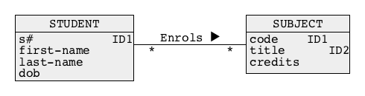
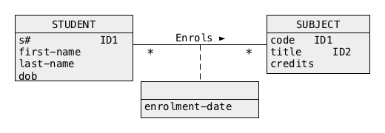
Link Attribute 链接属性
A link attribute is an attribute that describes an association
A student enrols a subject
An enrolment is performed on a given day, i.e. an enrolment is described by enrolment date
A link attribute is graphically represented by a "class-like" rectangular box without a name of class in a header
24
Notes:
<!-- Neural, Brian, Male, British English. -->
<speak>
<break time="0.5s"/>
<prosody rate="90%">
In this presentation, we look at a sample conceptual schema, that represents a database domain where students enrol in subjects.
<break time="0.3s"/>
The conceptual schema consists of two classes of objects, student and, subject, linked with an association enrolls.
<break time="0.3s"/>
A multiplicity of association enrols is, many to many, because a students is allowed to enroll in many subjects and a subject can be enroled by many students.
<break time="0.3s"/>
We would like to add to a conceptual schema, information about enrolment date of each enrolment, performed by a student.
<break time="0.3s"/>
If we add an attribute enrollment date to a class student, then such attribute must be a multivalued attribute, because a student can enrol in many subjects on many different days.
<break time="0.3s"/>
Additionally, we are not able to represent information what subject was enrolled on what date, because a conceptual schema does not represent the links between the values of multivalued attributes, and the instance of objects in another class.
<break time="0.3s"/>
An idea to add an attribute, enrolment date, to a class subject, fails because of the same reasons.
<break time="0.3s"/>
The attribute becomes multivalued attribute, because a subject may have many enrolments.
<break time="0.3s"/>
Additionally, the values of the attribute cannot be associated with the objects from a class student.
<break time="0.3s"/>
A correct solution to the problem is to add an attribute, enrolment date, as a link attribute.
<break time="0.3s"/>
A link attribute is an attribute that describes an association.
<break time="0.3s"/>
In our case, an association, student enrols in a subject, is described by a link attribute, enrolment date.
<break time="0.3s"/>
Such solution is correct, because enrolment fact is related to both object classes, student and subject.
<break time="0.3s"/>
An enrollment in a subject is performed by a student on a given day.
<break time="0.3s"/>
It means that enrollment is described by enrollment date.
<break time="0.3s"/>
A link attribute is visualised as a "class-like" rectangular box without a name of class in a header connected with a dashed line to a line representing an association.
<break time="0.5s"/>
</prosody>
</speak>
Systems Analysis
24

Slide 25
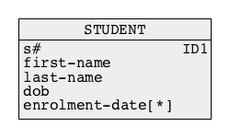
Link Attribute
Why an attribute enrolment-date must be represented by a link attribute ?
For example, what about an attribute enrolment-date describing a class STUDENT ?
Such design is incorrect because information about which subject has been enrolled on what date by a student is missing
A student is associated with a set of enrolment-dates, however ...
... there is no link between the values of an attribute enrolment-date and the objects in a class SUBJECT
25
Notes:
<!-- Neural, Brian, Male, British English. -->
<speak>
<break time="0.5s"/>
<prosody rate="90%">
Why an attribute: enrolment date, must be represented by a link attribute ?
<break time="0.3s"/>
For example, what about an attribute enrollment date describing a class student ?
<break time="0.3s"/>
Such design is incorrect, because information about the subjects enroled by a student on a given date, is missing.
<break time="0.3s"/>
This is because a value of an attribute cannot be directly connected to another class of objects.
<break time="0.3s"/>
A student is associated with a set of enrolment dates, however there is no link between the values of an attribute, enrolment date and the objects in a class SUBJECT
<break time="0.5s"/>
</prosody>
</speak>
Systems Analysis
25

Slide 26
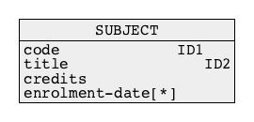
Link Attribute
So what about another option where an attribute enrolment-date describes a class SUBJECT ?
Such design is also incorrect because information about who enrolled in a subject and on a given date is missing
A subject is associated with a set of enrolment-dates, however ...
... there is no link between the values of an attribute enrolment-date and the objects in a class STUDENT
Therefore, the only option for an attribute enrolment-date is to be a link attribute
26
Notes:
<!-- Neural, Brian, Male, British English. -->
<speak>
<break time="0.5s"/>
<prosody rate="90%">
So, what about another option, where an attribute enrolment date describes a class subject ?
<break time="0.3s"/>
Such design is also incorrect, because information about who enroled in a subject on a given date, is missing.
<break time="0.3s"/>
A subject is associated with a set of enrolment dates, however there is no link between the values of an attribute enrolment date, and the objects in a class student.
<break time="0.3s"/>
Therefore, the only option, for an attribute enrolment date, is a link attribute describing an association, student enrols in given subject.
<break time="0.5s"/>
</prosody>
</speak>
Systems Analysis
26

Slide 27
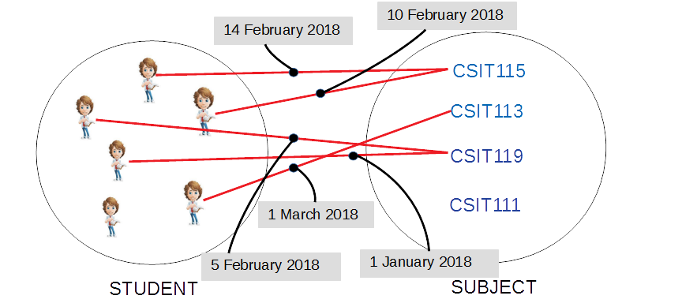
Link Attribute
It is correct because an attribute enrolment-date describes an association between the classes STUDENT and SUBJECT, i.e. the pairs of objects from the classes STUDENT and SUBJECT
27
Notes:
<!-- Neural, Brian, Male, British English. -->
<speak>
<break time="0.5s"/>
<prosody rate="90%">
A link attribute, enrolment date, is correct, because the attribute describes an association between the classes student and subject.
<break time="0.3s"/>
The association is a collection of homogeneous links between the pairs of objects that belong to the classes student and subject.
<break time="0.3s"/>
A value of link attribute can be visualised as a label attached to a link, connecting the instances of classes of objects student and subject.
<break time="0.5s"/>
</prosody>
</speak>
Systems Analysis
27

Slide 28
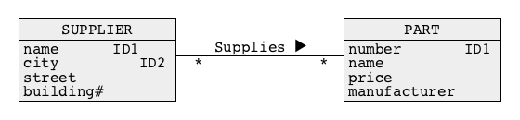
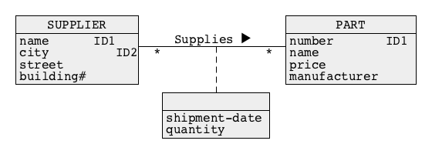
Link Attribute
Another example of link attribute
A supplier supplies a part
A shipment of a part is performed on a given day, i.e. a shipment is described by an attribute shipment-date and a shipment contains a given number of parts, i.e. a shipment is also described by an attribute quantity
28
Notes:
<!-- Neural, Brian, Male, British English. -->
<speak>
<break time="0.5s"/>
<prosody rate="90%">
Now, we consider few more examples of link attributes.
<break time="0.3s"/>
Assume, that we would like to present information, about suppliers supplying parts, and about the dates and quantities of shipments.
<break time="0.3s"/>
If a shipment of a part is performed on a given day, then it can be described by an attribute shipment date.
<break time="0.3s"/>
If a shipment contains a given number of parts, then a shipment is also described by an attribute quantity.
<break time="0.3s"/>
Both attributes, shipment date, and, quantity are the link attributes, describing an association supplies.
<break time="0.5s"/>
</prosody>
</speak>
Systems Analysis
28

Slide 29
Outline
Graphical Notations for Conceptual Modeling
(Simplified) Class of Objects
Association
Link Attribute
Association Class
Qualification
Generalisation
29
Notes:
<!-- Neural, Brian, Male, British English. -->
<speak>
<break time="0.5s"/>
<prosody rate="90%">
Association Class.
<break time="0.5s"/>
</prosody>
</speak>
Systems Analysis
29

Slide 30
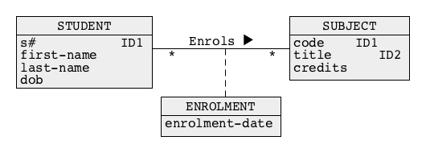
Association Class 关联类
An association class is a class that represents an association
A student enrols in a subject
An enrolment is performed on a given day, i.e. an enrolment is described by an attribute enrolment-date
An association class ENROLMENT is graphically represented in the same way as a class of objects
30
Notes:
<!-- Neural, Brian, Male, British English. -->
<speak>
<break time="0.5s"/>
<prosody rate="90%">
A class of objects is a collection of homogeneous instances of objects, described by almost the same set of attributes.
<break time="0.3s"/>
If we consider the links as objects, then a collection of homogeneous links, described by almost the same set of attributes becomes a class of objects.
<break time="0.3s"/>
Such class of objects consists of a collection of objects (links) that represents an association between two classes of objects.
<break time="0.3s"/>
This is why, a class of objects that consists of links, is called as, an association class.
<break time="0.3s"/>
It is correct to say, that an association class is a class that represents an association.
<break time="0.3s"/>
Let’s consider a database domain, where students enrol in subjects.
<break time="0.3s"/>
Such domain can be represented by a conceptual schema, where the classes, student and subject, are linked with an association, enrols.
<break time="0.3s"/>
If we would like to consider the links between students and subjects as objects, then a collection of such links becomes an association class called as enrolment.
<break time="0.3s"/>
If we record a fact that enrolment is performed on a given day, then the association class is described by an attribute enrolment date.
<break time="0.3s"/>
An association class enrolment is graphically represented in the same way as a class of objects with a dashed line connecting a class box with an association and a name of a class in a header.
<break time="0.3s"/>
An association class, is the same class as other classes of objects, and it can be involved in the associations with other classes of objects.
<break time="0.3s"/>
It is also possible to upgrade a link attribute to an association class.
<break time="0.3s"/>
To do so, we apply a procedure of reification, that transforms an attribute into a class of objects.
<break time="0.3s"/>
In our case a link attribute or a group of link attributes is promoted into a class of objects, enrolment.
<break time="0.5s"/>
</prosody>
</speak>
Systems Analysis
30

Slide 31
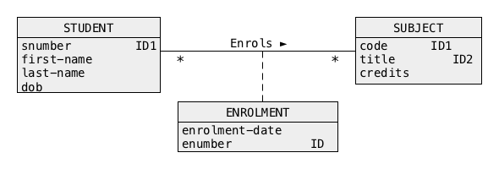
Association Class
What about an identifier of an association class ?
An association class may have its own identifiers, e.g. enrolment-number in a class ENROLMENT
An association class that represents a many-to-many association has a default identifier that consists of identifiers of the classes from both sides of association, e.g. (snumber, code) in a class ENROLMENT
There is no need to include a default identifier into a description of a class of objects
31
Notes:
<!-- Neural, Brian, Male, British English. -->
<speak>
<break time="0.5s"/>
<prosody rate="90%">
An interesting problem related to association classes, is a question about an identifier of association class.
<break time="0.3s"/>
From where, do we get an identifier of an association class ?
<break time="0.3s"/>
An association class may have its own identifiers, for example, an attribute enrolment number in a class enrolment.
<break time="0.3s"/>
If such identifier does not exist in reality, then it is always possible to create a composite identifier, from the identifiers of the classes of objects involved in the association.
<break time="0.3s"/>
An association class, that represents many to many association has a default identifier, that consists of the identifiers of classes from both sides of the association.
<break time="0.3s"/>
For example, a pair of attributes: student number (s number) and code, is an identifier of a class enrollment.
<break time="0.3s"/>
Such identifier is created by concatenation of an identifier from a class student (student number), and identifier from a class subject, (subject code).
<break time="0.3s"/>
A pair of attributes: s number and title, can also be used as an identifier of a class enrolment.
<break time="0.3s"/>
Then, there is no need to include an artificial identifier, like enrolment number, into a description of a class of objects
<break time="0.5s"/>
</prosody>
</speak>
Systems Analysis
31

Slide 32
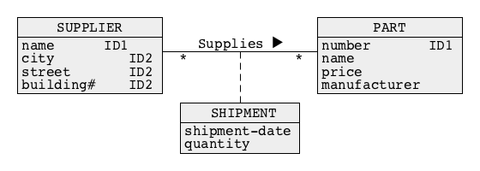
Association Class
Another example of association class
A supplier supplies a part
A shipment of a part is performed on a given day, i.e. a shipment is described by an attribute shipment-date and a shipment contains a given number of parts, i.e. a shipment is also described by an attribute quantity
32
Notes:
<!-- Neural, Brian, Male, British English. -->
<speak>
<break time="0.5s"/>
<prosody rate="90%">
Now, let us look at another example of association class.
<break time="0.3s"/>
We consider a database domain, where suppliers supply parts.
<break time="0.3s"/>
Such domain can be represented by a conceptual schema, where the classes of objects, supplier and part, are linked with an association supplies.
<break time="0.3s"/>
If we would like to consider the links between suppliers and parts as instances of objects, then a collection of such links becomes an association class shipment.
<break time="0.3s"/>
If a shipment of a part is performed on a given day, then the shipment is described by an attribute as: shipment date.
<break time="0.3s"/>
If a shipment includes many parts, then it is also described by attribute: quantity.
<break time="0.3s"/>
An association class, shipment represents and association supplies.
<break time="0.5s"/>
</prosody>
</speak>
Systems Analysis
32

Slide 33
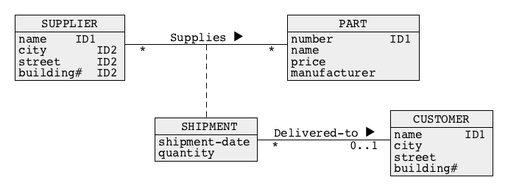
Association Class
Why do we need association classes ?
A shipment is delivered to a customer
An association Delivered-to connects the classes SHIPMENT and CUSTOMER
In a general case, it is possible to create associations between association classes and other classes of objects and between association classes and association classes
33
Notes:
<!-- Neural, Brian, Male, British English. -->
<speak>
<break time="0.5s"/>
<prosody rate="90%">
Why do we need association classes, and what can we use association classes for ?
<break time="0.3s"/>
Let us extend a database domain described in the previous slide, with information about shipments delivered to customers.
<break time="0.3s"/>
An association, delivered to, connects an association class shipment, and a class customer.
<break time="0.3s"/>
In a general case, it is possible to create associations between association classes, and other classes of objects, and even between association classes and other association classes.
<break time="0.3s"/>
A concept of association class, also allows for modeling of associations between more then two classes of objects.
<break time="0.3s"/>
A conceptual schema on the slide, uses an association class shipment to represent a ternary association, whose arguments are suppliers, parts, and customers.
<break time="0.5s"/>
</prosody>
</speak>
Systems Analysis
33

Slide 34
Outline
Graphical Notations for Conceptual Modeling
(Simplified) Class of Objects
Association
Link Attribute
Association Class
Qualification
Generalisation
34
Notes:
<!-- Neural, Brian, Male, British English. -->
<speak>
<break time="0.5s"/>
<prosody rate="90%">
Qualification.
<break time="0.5s"/>
</prosody>
</speak>
Systems Analysis
34

Slide 35
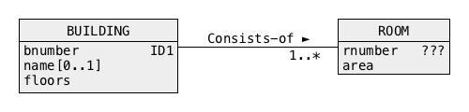
Qualification
A building at a university campus is described by a unique number, optional name and the total number of floors
A room is described by a number and area
A building consists of rooms
What is an identifier of a class ROOM ?
Identifier of a class ROOM is a composite identifier and it consists of the attributes bnumber from a class BUILDING and rnumber from a class ROOM
How do we represent composite identifiers that consist of attributes from more than one class ?
We use a qualification !
35
Notes:
<!-- Neural, Brian, Male, British English. -->
<speak>
<break time="0.5s"/>
<prosody rate="90%">
Let us consider a database domain of a university campus, where the buildings are located on a campus, and the rooms are located within each building.
<break time="0.3s"/>
A building at a university campus is described by a unique building number, optional building name and the total number of floors.
<break time="0.3s"/>
A room is described by a room number and an area.
<break time="0.3s"/>
A building consists of rooms.
<break time="0.3s"/>
A conceptual schema of the database domain is visible in the middle of the present slide.
<break time="0.3s"/>
A building is identified by an attribute building number (b number attribute in a class building).
<break time="0.3s"/>
What is an identifier of a class room ?
<break time="0.3s"/>
An attribute room number (r number) is not an identifier, because many different buildings have the rooms with the same numbers.
<break time="0.3s"/>
Is it worth to create, and to use an artificial identifier, like for example room i d.
<break time="0.3s"/>
Such identifier is completely useless in practice, because it does not provide information which building hosts a room with a given room i d.
<break time="0.3s"/>
For example, it would be hard to find a location of a room 546 because such number does not provide any information about the building number, and searching for a room by traversing the buildings one by one would be too time consuming.
<break time="0.3s"/>
In reality, identifier of a class room is a composite identifier, that consists of the attributes building number from a class building, and room number from a class room.
<break time="0.3s"/>
How do we represent the composite identifiers that consist of the attributes from more than one class ?
<break time="0.3s"/>
We use a qualification !
<break time="0.5s"/>
</prosody>
</speak>
Systems Analysis
35

Slide 36
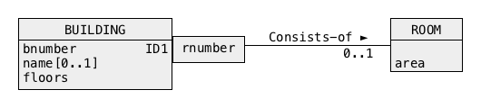
Qualification
A building at a university campus is described by a unique number, optional name and the total number of floors. A room is described by a number and area. A building consists of rooms
A qualification is represented by a rectangle with one or more attribute names
In the example above a qualification means that in a given building there is at most one room with a given number
It also means that an attribute rnumber is a local identifier in a class ROOM, i.e. all rooms in a given building have different numbers
A pair of attributes (bnumber, rnumber) is a default identifier of a class ROOM
36
Notes:
<!-- Neural, Brian, Male, British English. -->
<speak>
<break time="0.5s"/>
<prosody rate="90%">
<break time="0.3s"/>
A qualification is visualised as a rectangular box, that contains one or more attribute names.
<break time="0.3s"/>
A box with the attribute names is on one side attached to a class of objects, and on the other side to an association.
<break time="0.3s"/>
The other side of association is attached to a class of objects, that does not have its own identification system, for example a class, room.
<break time="0.3s"/>
A qualification of a class building, and association consists of, with an attribute room number (r number) means, that in each building there is at most one room with a given number.
<break time="0.3s"/>
Please, note 0 . . 1 (optional) multiplicity of an association Consists of on its right hand side.
<break time="0.3s"/>
For example, there is a most one room number 17 in a building number 35.
<break time="0.3s"/>
Such rule applies to all buildings on a campus and to all rooms in the buildings.
<break time="0.3s"/>
It means that an attribute, room number, is a local identifier in a class room, because all rooms in a given building have different numbers.
<break time="0.3s"/>
It also means that a pair of attributes building number and room number, is a global identifier of a class, room.
<break time="0.3s"/>
This is how an identifier of a class, room is created from concatenation of identifier of a class building and an attribute taken from a class, room, and included in a qualification box.
<break time="0.3s"/>
The names of attributes located within a qualification box, together with an identifier of class the box is attached to, become an identifier of a class on the other side of qualified association.
<break time="0.3s"/>
This is why a pair of attributes room number and building number is an identifier of a class room.
<break time="0.3s"/>
In a general case, qualification should be used in a situation, when a class of objects does not have its own identification system, like in a case of rooms located in university buildings.
<break time="0.5s"/>
</prosody>
</speak>
Systems Analysis
36

Slide 37
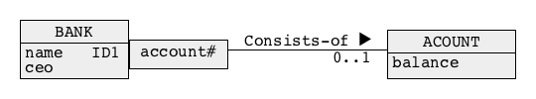
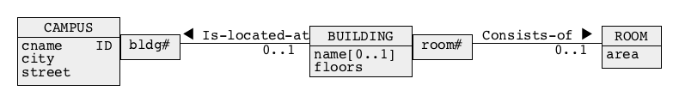

Qualification
More examples:
A bank account is located at a bank
A campus consists of buildings and the buildings consist of the rooms
A company is listed at a stock exchange
37
Notes:
<!-- Neural, Brian, Male, British English. -->
<speak>
<break time="0.5s"/>
<prosody rate="90%">
Now, we shall consider few more examples, where a qualification is used to determine an identifier of a class of objects.
<break time="0.3s"/>
First, we look at a database domain, where banks host bank accounts.
<break time="0.3s"/>
A conceptual schema of such domain consists of two classes of objects, bank, and account.
<break time="0.3s"/>
An association, bank consists of account, links the classes of objects bank and account.
<break time="0.3s"/>
A question is, what is an identifier of a bank account ?
<break time="0.3s"/>
Definitely, an account number is not an identifier because the banks do not synchronise among themselves the numbers of bank accounts.
<break time="0.3s"/>
On the other hand, an account number is a local identifier within a bank.
<break time="0.3s"/>
This is why we use qualification to express a fact, that an account is identified by a pair of attributes, bank name and account number.
<break time="0.3s"/>
In the next example, we consider a database domain where a university has a number of campuses, buildings are located at campuses, and rooms are located within buildings.
<break time="0.3s"/>
This time we ask about the identifiers of the classes building and room.
<break time="0.3s"/>
An identifier of a building is a pair of attributes campus name (c name) and building number.
<break time="0.3s"/>
This is because each building at a campus has a unique number.
<break time="0.3s"/>
This is why a class campus is qualified with an attribute, building number.
<break time="0.3s"/>
Next, we ask about an identifier of a class room ?
<break time="0.3s"/>
If each room has a unique number within a building, then a global identifier of a class room, consists of identifier of a building, and a local identifier room number.
<break time="0.3s"/>
Therefore, an identifier of a class room is a triple of attributes, campus name, building number, and room number.
<break time="0.3s"/>
In the last example we look at a database domain where companies are listed on the stock exchange.
<break time="0.3s"/>
An identifier of a class company is obtained from qualification of a class stock exchange and association, is listed at, with an attribute ticker symbol.
<break time="0.3s"/>
It means that a company is uniquely identified by a location of the stock exchange and its ticker symbol at a stock exchange where the company is located.
<break time="0.3s"/>
Note, that in this particular domain, a company can be listed on many different stock exchanges, and because of that stock exchange side of association, is listed at is one or many and entire association, is listed at, is many to many.
<break time="0.5s"/>
</prosody>
</speak>
Systems Analysis
37

Slide 38
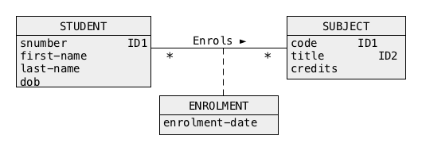
Qualification
Sometimes a qualification is needed for many-to-many associations
For example, if you consider a pessimistic view of students who enroll in subjects then sometimes a student must enrol in the same subject more than once (well, ... you know when it happens and why it is a "pessimistic" view of reality)
The original design created few slides ago was the following
But, ... if enrolment is repeated several times than a pair od attributes(snumber, code) is no longer an identifier of a class ENROLMENT !
38
Notes:
<!-- Neural, Brian, Male, British English. -->
<speak>
<break time="0.5s"/>
<prosody rate="90%">
Sometimes, a qualification must be applied to both sides of many to many association.
<break time="0.3s"/>
As a simple example, consider a database domain, where students enroll in subjects, and subjects are enrolled by students.
<break time="0.3s"/>
A conceptual schema for such domain is visible in the middle of a slide,
<break time="0.3s"/>
A question is, what is an identifier of an association class enrollment ?
<break time="0.3s"/>
As it has been mentioned earlier, a default identifier of an association class enrolment, consist of a pair of attributes, student number and subject code.
<break time="0.3s"/>
But, what if a student must enroll in the same subject twice ?
<break time="0.3s"/>
If we consider a pessimistic view of the reality, then sometimes a student must enroll in the same subject more than once, (well, ... I guess that everyone knows when it happens and why it is a "pessimistic" view of the reality)
<break time="0.3s"/>
In such a case, a pair of attributes, student number and subject code, is no longer an identifier of an enrolment, because two enrolments have the same values of the attributes, student number and subject code.
<break time="0.3s"/>
If the enrolments of the same subject by the same student are repeated several times, than a pair of attributes student number and code, is no longer an identifier of a class enrolment !
<break time="0.3s"/>
To solve the problem, we append an attribute enrollment date to the identifier, and we assume that a student cannot on the same day enrol a subject, drop it, end enrol in it again.
<break time="0.3s"/>
It means that the left hand size of an association enrols must be qualified with the attributes subject code and enrolment date, and the right hand size of an association, must be qualified with a student number and enrolment date.
<break time="0.5s"/>
</prosody>
</speak>
Systems Analysis
38

Slide 39
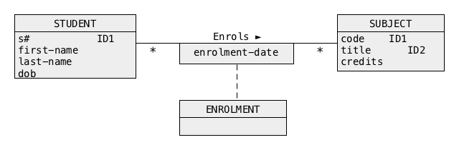
Qualification
If enrolment is repeated several times then an identifier of a class ENROLMENT is a triple (snumber, code, enrolment-date)
How is this fact represented graphically ?
It is represented by a qualification of the middle part of the association Enrols in the following way
Qualification of the middle part of many-to-many association means that the identifier of an association class consists of an identifier of a class on the left hand side of association, identifier of a class on the right hand side of association and qualification attribute(s)
39
Notes:
<!-- Neural, Brian, Male, British English. -->
<speak>
<break time="0.5s"/>
<prosody rate="90%">
To avoid the qualifications on both sides of an association, we attach a qualification box in the middle of the association line, and we connect it with a dashed line to an association class.
<break time="0.3s"/>
If enrolment is repeated several times, then an identifier of an association class enrollment is a triple: student number, subject code, and enrollment date.
<break time="0.3s"/>
Such identifier is represented by a qualification box in the middle of an association enrolls.
<break time="0.3s"/>
Qualification of the middle part of many-to-many association, means that identifier of an association class, consists of an identifier of a class on the left hand side of association, identifier of a class on the right hand side of association, and the attributes included in a qualification box.
<break time="0.5s"/>
</prosody>
</speak>
Systems Analysis
39

Slide 40
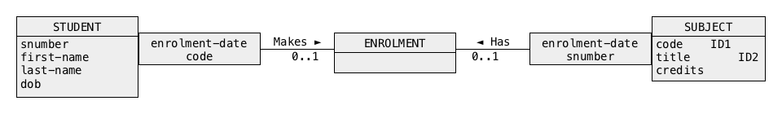
Qualification
A qualification of the middle part of many-to-many-association is equivalent to the following two single-side qualifications of one-to-many association and many-to-one association
40
Notes:
<!-- Neural, Brian, Male, British English. -->
<speak>
<break time="0.5s"/>
<prosody rate="90%">
A qualification box, in the middle part of many to many association, is equivalent to the following two single side qualifications, of one-to-many association and many-to-one association.
<break time="0.3s"/>
</prosody>
</speak>
Systems Analysis
40

Slide 41
Outline
Graphical Notations for Conceptual Modeling
(Simplified) Class of Objects
Association
Link Attribute
Association Class
Qualification
Generalisation
41
Notes:
<!-- Neural, Brian, Male, British English. -->
<speak>
<break time="0.5s"/>
<prosody rate="90%">
Generalisation.
</prosody>
</speak>
Systems Analysis
41

Slide 42
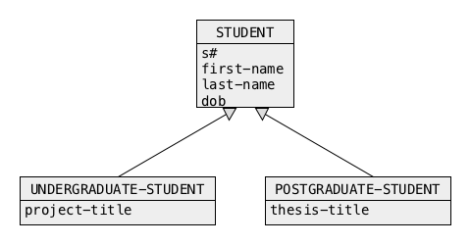
Generalisation
A generalisation hierarchy represents IS-A-subset relation between the sets of objects
A set of all undergraduate students is a subset of a set of students, i.e. an undergraduate student IS-A student
A set of all postgraduate students is a subset of a set of students, i.e. a postgraduate student IS-A student
A generalisation hierarchy is built with arrows pointing from a subclass of objects to a superclass of objects
42
Notes:
<!-- Neural, Brian, Male, British English. -->
<speak>
<break time="0.5s"/>
<prosody rate="90%">
A generalisation hierarchy, represents is a subset relation between the sets of objects.
<break time="0.3s"/>
For example, a set of all undergraduate students, is a subset of a set of students.
<break time="0.3s"/>
It means, that an undergraduate student is a student.
<break time="0.3s"/>
A set of all postgraduate students, is also a subset of a set of students, and it also means, that a postgraduate student is a student.
<break time="0.3s"/>
A generalisation hierarchy is visualised as arrows pointing from a subclass of objects to a superclass of objects.
<break time="0.3s"/>
</prosody>
</speak>
Systems Analysis
42

Slide 43
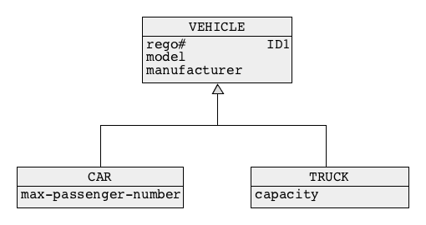
Generalization
Another visualization of generalization hierarchy:
A car IS-A vehicle and a truck IS-A vehicle
To create a nice effect the arrows can be "joined" into a single arrow
43
Notes:
<!-- Neural, Brian, Male, British English. -->
<speak>
<break time="0.5s"/>
<prosody rate="90%">
This slide presents another visualization of generalisation hierarchy, where each car is a vehicle, and each truck is a vehicle.
<break time="0.3s"/>
To create a nice visualisation, the subclasses are connected to the super classes by the arrows joined in the middle into a single arrow.
<break time="0.5s"/>
</prosody>
</speak>
Systems Analysis
43

Slide 44
Entity-Relationship Modeling 实体-关系（ER）建模
Entity-Relationship Modeling is another graphical conceptual modeling notation
Graphically it is very similar to Object Modeling
视觉表示可以看作与对象建模相似。这使得它即使对于非技术利益相关者也是直观易懂的。
The following concepts from the notations are equivalent:
- Class of objects = Entity type
- Object = Entity instance
- Association = Relationship
- Identifier = Primary key or Candidate key
- Qualification = Weak entity type
44
Notes:
<!-- Neural, Brian, Male, British English. -->
<speak>
<break time="0.5s"/>
<prosody rate="90%">
At the end, we present a short comparison of Entity Relationship notation, and Object Modeling notation.
<break time="0.3s"/>
Entity relationship notation is presented in your texbook.
<break time="0.3s"/>
Entity relationship notation is very similar to Object Modeling notation.
<break time="0.3s"/>
The following concepts are equivalent:
<break time="0.3s"/>
Class of objects is equivalent to Entity type
<break time="0.3s"/>
Object is equivalent to Entity instance
<break time="0.3s"/>
Association is equivalent to Relationship
<break time="0.3s"/>
Identifier is equivalent to Primary key or Candidate key
<break time="0.3s"/>
Qualification is equivalent to Weak entity type
<break time="0.5s"/>
</prosody>
</speak>
Systems Analysis
44

Slide 45
References
C. Coronel, S. Morris, A. Basta, M. Zgola, Data Management and Security, Chapters 2, 3, and 4 Cengage Compose eBook, 2018, eBook: Data Management and Security, 1st Edition
T. Connoly, C. Begg, Database Systems, A Practical Approach to Design, Implementation, and Management, Chapter 12 Entity-Relationship Modeling, Chapter 13.1 Specialization/Generalization, Pearson Education Ltd, 201
45
Notes:
<!-- Neural, Brian, Male, British English. -->
<speak>
<break time="0.5s"/>
<prosody rate="90%">
References.
<break time="0.5s"/>
</prosody>
</speak>
Systems Analysis
45

